Slide 1
Faceless Chat App

Slide 2
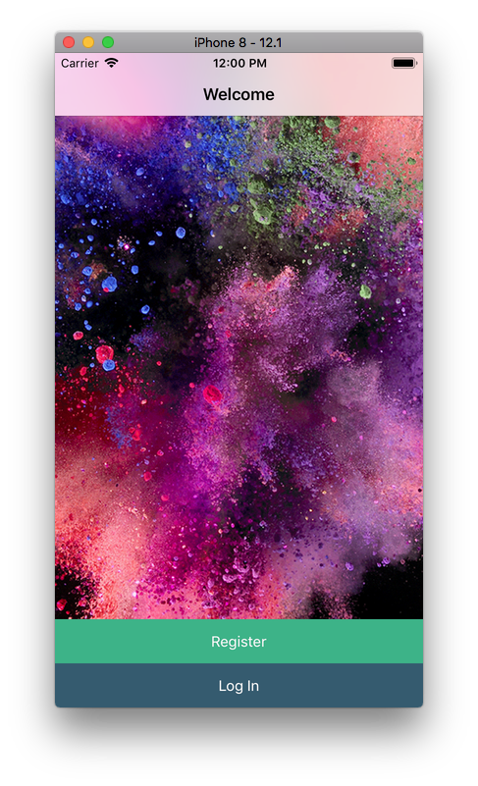
The app
A messaging app with one chat room in which every users ID
is random making them anonymous.
Why this app ?

Slide 3
Challenges
Planning stage
Deciding what to do / create.
Choosing platform
How we were overachievers
Swift
New language

Slide 4
challenges
app development
Swift is restrictive
Leaning new language within a short time
Swift compared to languages we are familiar to

Slide 5
DEMO the app

Slide 6

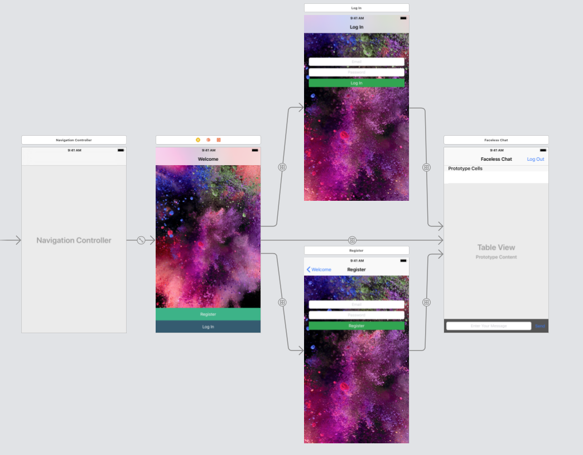

Slide 7
Features
Sign up
Log in
Enter Chat Room
Color coordinated messages
Unique ID for each user
Messages being synced even after logout

Slide 8
The code
App runs on collection of objective c, ruby on rails, and swift.
Backend is Firebase (google database service)
Dynamic, will work on any iOS device
Can be integrated to any android device, as firebase is device agnostic

Slide 9
Compromises
Was unable to do hashing function
Interfered with color coordinated messages
No 1-1 messaging
No temporary messages

Slide 10
Potential fixes
Have to rebuild the messages and user object to include these new features
Must integrated into firebase to store these new states
Change the logic of how users and messages are displayed
Limited time, decided to skip to have a viable product

Slide 11
Q and A

